Slide 1


Introduction to Key Concepts in Buddhism
for RMPS Teachers
Dr Naomi Appleton
University of Edinburgh, naomi.appleton@ed.ac.uk
Dr Chris Jones
University of Cambridge, cvj20@cam.ac.uk
Feb-Jun 2021

Slide 2
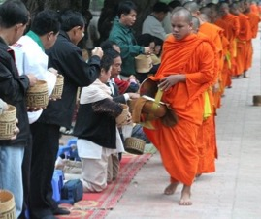
Programme
February 9th Buddha, Dhamma, and Saṅgha (‘The Three Jewels’)
March 9th Dukkha, Anicca, and Anattā (‘Three Marks of Existence’)
April 13th Saṃsāra, Kamma, and Nibbāna
May 11th The Eightfold Path and Five Precepts
June 8th Meditation and Worship (Pūjā)
Each session will consist of roughly 30 minutes of presentation, and up to 30 minutes of questions and/or discussion.
The presentation (though not the discussion) will be recorded. Please keep cameras off during this part of the event.
Image from www.thai-blogs.com
Notes:
Depicted is a typical image (many can be found online) of Buddhist monks, in this case from Thailand, on a daily alms-round. A combination of ancient monastic regulations (vinaya) and local custom dictate how monastics, who are not permitted to work or earn money, receive gifts from the laity. These gifts range from daily offerings of food, collected in the mornings by monks who visit devotees near or at their homes, to vast sums of money donated to the Saṅgha by royalty, businesses or other wealthy supporters.
Why do Buddhist laity make offerings to monks? Genuine altruism notwithstanding, from an early stage in its history Buddhism has presented the Saṅgha and its monks (and nuns) as each a fertile ‘field of merit’ (puññakhetta). Buddhists of all kinds are interested in doing good deeds (karma) to receive a better rebirth; Buddhist renouncers, who sustain the Dharma in the world, are the best kinds of recipients of donations (next to the Buddha himself), so monks by their dependence upon the laity provide for them ‘fertile soil’ in which to plant the ‘seeds’ of good deeds, which will bear ‘fruit’ (happy results) in this life or the next.

Slide 3
The (Noble) Eightfold Path
Right View (diṭṭhi)
Right Intention (saṅkappa)
Right Speech (vācā)
Right Action (kammanta)
Right Livelihood (ājīva)
Right Effort (vāyāma)
Right Mindfulness (sati)
Right Concentration (samādhi)
Wisdom
(paññā)
Conduct
(sīla)
Meditation
(samādhi)
Notes:
There is much, much more that could be said about ‘right view’ especially; indeed, much Buddhist teaching could be said to be concerned with what our ‘right view’ should be respect to our identity and experience. However, early Buddhist literature is at least as concerned with articulating what are wrong views, of perspectives on the world that are unhelpful or insidious (e.g., ideas about an enduring self, as discussed in an earlier session), or simply redundant and therefore distracting (e.g., speculations about other metaphysical questions, such as with respect to the origin of the universe and so forth). An important early ‘catalogue’ of wrong views is the Brahmajāla-sutta, canonically the very first discourse of the Buddha in the Pāli canon; this is a difficult read even in English translation, but can be found here: https://www.accesstoinsight.org/tipitaka/dn/dn.01.0.bodh.html.
More will be said about meditation in the next session.

Slide 4
The (Noble) Eightfold Path
Right View (diṭṭhi)
Right Intention (saṅkappa)
Right Speech (vācā)
Right Action (kammanta)
Right Livelihood (ājīva)
Right Effort (vāyāma)
Right Mindfulness (sati)
Right Concentration (samādhi)
…knowledge about Four Truths, impermanence and non-self, and avoiding false views.
…resolve to renounce domestic life (as a monk/nun), and to not harm other living beings.
…abstention from lies, abuse and idle chatter.
…abstention from harm, stealing and sexual misconduct.
…abstention from vocations that infringe upon other aspects of the path (complicated…)
…exertion and persistence with respect to mental training and habits that result from it.
…attentiveness always to one’s mind and its behaviour.
…practices meditative techniques focused on states of focused, calm absorption (jhāna – more on this in the next session).
Notes:
A typical account of what is intended by the Eight ‘Limbs’ (aṅgas) of the path is that of the Mahāvibhaṅga-sutta (canonical ref. SN 45.8), which can be found here: https://www.accesstoinsight.org/tipitaka/sn/sn45/sn45.008.than.html.

Slide 5
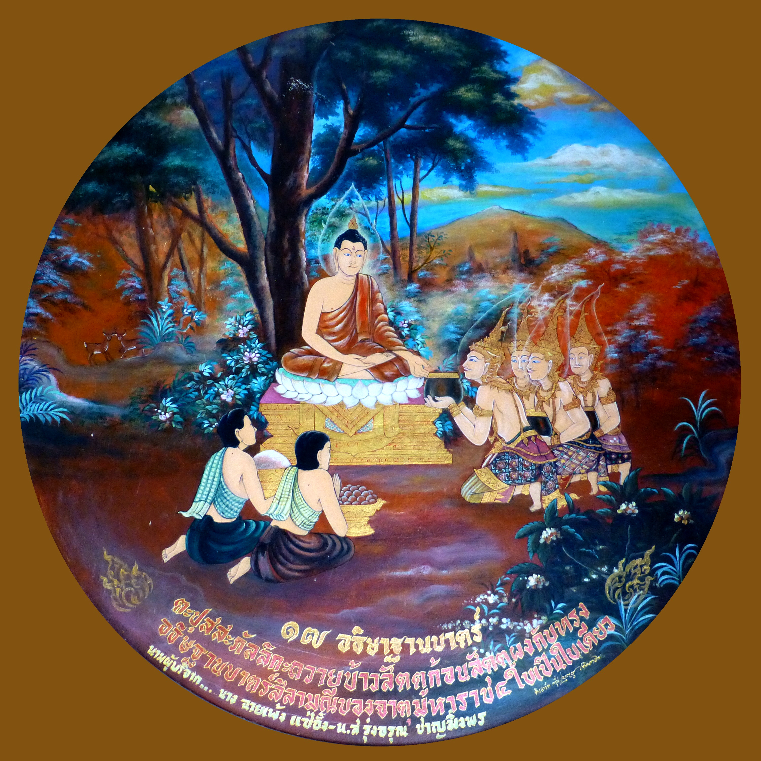
The Five Precepts (pañcasīlāni)
To refrain from destroying living beings
To refrain from taking that which is not given
To refrain from sexual misconduct
To refrain from incorrect speech
To refrain from intoxicating substances
The first lay followers of the Buddha
Image: Photo Dharma from Sadao
Notes:
For the full text of the five precepts, and links to discussions of the lists of eight and ten, see https://www.accesstoinsight.org/ptf/dhamma/sila/pancasila.html
Image: Photo Dharma from Sadao, Thailand - 041 Tapussa and Bhallika give Food to Buddha who turns Four Almsbowls into One, in the Chedi Traiphop Traimongkhon Temple, Hatyai. CC BY 2.0, https://commons.wikimedia.org/w/index.php?curid=50795066
The merchants Tapussa and Bhallika were the first lay Buddhists, after making an offering to the Buddha, and taking refuge in the Buddha and his Dhamma (there being no Sangha yet). Although the precepts are not usually mentioned in that story, they became – along with taking refuge – the definition of becoming a lay follower for the Buddha. As we will discuss further in the next session, making an offering to the Buddha is also a key lay Buddhist act. This being the first such offering after the Buddha’s awakening, he has no bowl in which to receive it. Hence four gods appear and each present a bowl; the Buddha magically combines the four into one bowl, in which he can receive the first gift from his first followers.

Slide 6
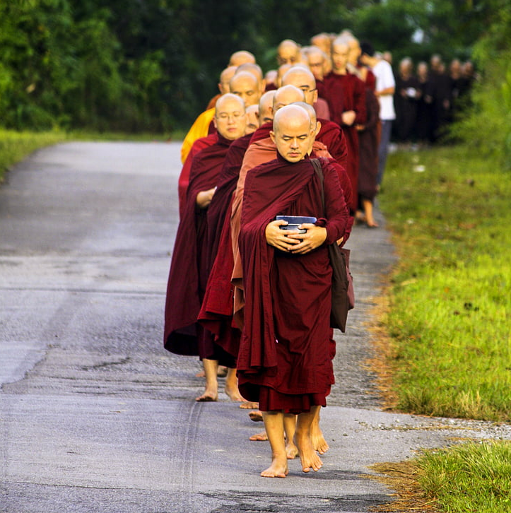
There is no such thing as a minor defilement…
From the Pānīya Jātaka (‘Water Story’)
“Though a friend, I stole the water of a friend.
Later I loathed that bad deed I had done.
I renounced so I would not do evil again.”
“I saw another’s wife, and desire arose.
Later I loathed that bad deed I had done.
I renounced so I would not do evil again.”
“Great king, thieves snatched my father in the forest,
And I answered their question one way, knowing it was otherwise.
Later I loathed that bad deed I had done.
I renounced so I would not do evil again.”
“Beings were killed for the sacrifice,
And I gave my permission.
Later I loathed that bad deed I had done.
I renounced so I would not do evil again.”
“The people first got drunk on spirits and more,
And caused a great deal of harm in their drinking bout,
And I gave my permission.
Later I loathed that bad deed I had done.
I renounced so I would not do evil again.”
Monks on an alms-round (see note for credit)
Notes:
For the full story and some suggested discussion questions see https://blogs.ed.ac.uk/teachingbuddhism/2021/04/29/a-story-about-the-five-precepts/
The image is copyright free (CC-zero) and depicts the almsround of Buddhist monks: https://www.hippopx.com/en/sangha-in-line-pindacara-pindapata-theravada-monks-alms-round-buddhist-monks-religion-107211
The deportment of monks and other renouncers is often commented on in Buddhist texts, as it has the capacity to deeply impress laypeople (including, in our story, royalty) and lead to their benefit. Note that the renouncers in our story do not become Buddhist monks, since there are no Buddhist teachings or institutions at the time in which the story is set.

Slide 7
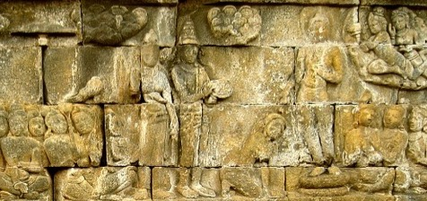
On right livelihood (and the complexities thereof…)
From the Vaṇijjā-sutta
(‘the discourse on trades’)
‘Monks, a lay devotee should not engage in five types of trade.
Which five? Trade in weapons, in human beings, in meat, in intoxicants and in poisons.
A (very short!) extract from the Mahāvagga
(‘the Great Chapter’, which begins the Buddhist Vinaya, or monastic legal literature)
(King Bimbisāra, to the Buddha:)
‘Lord, there are kings who have no faith, not believing [in the Dharma]. It would be good, Lord, if the masters [in the Saṅgha] did not let one who is in a king’s service go forth [i.e., renounce and become a monk].’
(The Buddha, to his monks:)
‘Monks, one who is in a king’s service should not be let to renounce; who allows this commits an offence [as a monk].’
Image credit Anandajoti Bhikkhu: see note for full details
Notes:
Another translation of the Vaṇijjāsutta (canonical reference AN 5.177) can be found here: https://www.accesstoinsight.org/tipitaka/an/an05/an05.177.than.html
Some sections of the Mahāvagga can be found translated here: https://www.accesstoinsight.org/tipitaka/vin/mv/index.html; however, this does not include the passage translated here, explained in full in the video. For this, one might best see I.B. Horner’s (1951) The Book of the Discipline (Vinaya-Piṭaka), vol. IV (Mahāvagga), Pali Text Society, pp.91–92.
The image depicts an encounter between the Buddha and the King Bimbisāra, a contemporary and (traditionally) a devotee of the Buddha who ruled over the North Indian kingdom of Magadha in the C5th BCE. The image is covered by Creative Commons Attribution, so free to use if credit is supplied, and is by Anandajoti Bhikkhu, uploaded by Ibolya Horvath (https://www.worldhistory.org/image/11562/bimbisara--the-bodhisattva/). This is a stone relief produced in likely the ninth century, taken from the Buddhist monument Borobodur (contemporary Java, Indonesia), which is undoubtedly one of the wonders of the Buddhist world: https://en.wikipedia.org/wiki/Borobudur.

Slide 8
Programme
February 9th Buddha, Dhamma, and Saṅgha (‘The Three Jewels’)
March 9th Dukkha, Anicca, and Anattā (‘Three Marks of Existence’)
April 13th Saṃsāra, Kamma, and Nibbāna
May 11th The Eightfold Path and Five Precepts
June 8th Meditation and Worship (Pūjā)
Each session will consist of roughly 30 minutes of presentation, and up to 30 minutes of questions and/or discussion.
The presentation (though not the discussion) will be recorded. Please keep cameras off during this part of the event.
Image from www.thai-blogs.com
Notes:
Depicted is a typical image (many can be found online) of Buddhist monks, in this case from Thailand, on a daily alms-round. A combination of ancient monastic regulations (vinaya) and local custom dictate how monastics, who are not permitted to work or earn money, receive gifts from the laity. These gifts range from daily offerings of food, collected in the mornings by monks who visit devotees near or at their homes, to vast sums of money donated to the Saṅgha by royalty, businesses or other wealthy supporters.
Why do Buddhist laity make offerings to monks? Genuine altruism notwithstanding, from an early stage in its history Buddhism has presented the Saṅgha and its monks (and nuns) as each a fertile ‘field of merit’ (puññakhetta). Buddhists of all kinds are interested in doing good deeds (karma) to receive a better rebirth; Buddhist renouncers, who sustain the Dharma in the world, are the best kinds of recipients of donations (next to the Buddha himself), so monks by their dependence upon the laity provide for them ‘fertile soil’ in which to plant the ‘seeds’ of good deeds, which will bear ‘fruit’ (happy results) in this life or the next.

