Slide 1


CVs for Non-Academic Jobs
Sara Shinton
Head of Researcher Development

Slide 2
Key Content
Vital messages about CV writing
Relating employer needs to your skill set
“Live” CV Review against a sample job
Questions

Slide 3
Why our visual motif?
Tangram
  All pieces remain the same
  The way they combine and are selected gives us infinite variety…
Your CV needs to do the same
  We’re talking about the same content
  We present it in different styles and context
  We draw attention with different emphasis

Slide 4
First VITAL message
A CV is tailored to a specific role and vacancy

Slide 5
A few assumptions
You want the job you’re applying for
You think your experience is valid and valuable
You are making a planned transition and have developed the necessary skills

Slide 6
We start ALWAYS with the employer
They will tell us what they are looking for through…
The advert
Their online presence and recruitment literature

Slide 7
We start ALWAYS with the employer
They will tell us what they are looking for through…
The advert
Their online presence and recruitment literature
Then we find out more by…
  Talking to people
  Looking at their wider online presence
  Knowing the role and the sector

Slide 8
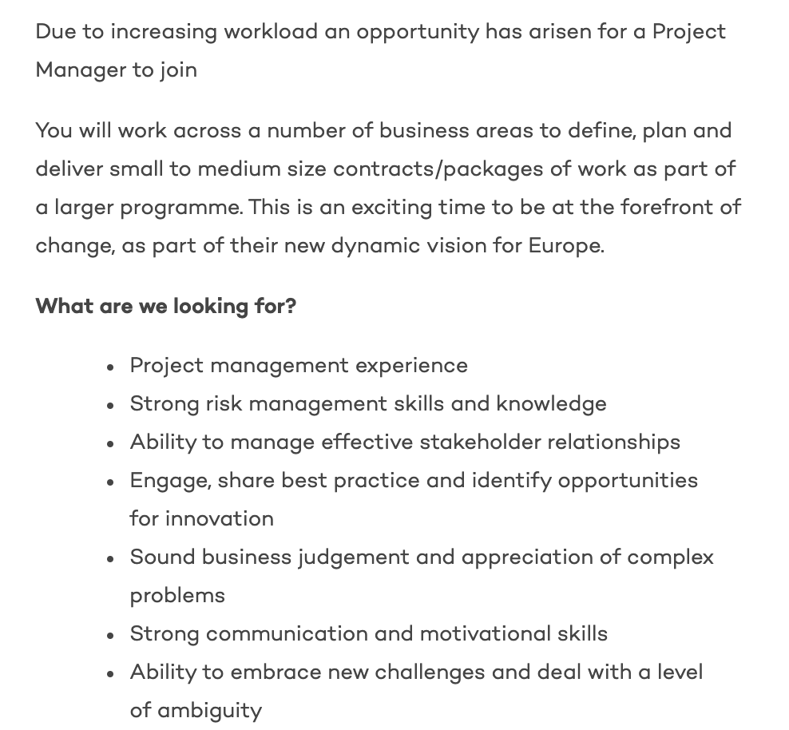
For example – a well written advert is full of pointers

Slide 9
In addition to the information in the advert
… we need to anticipate the employer’s mind set as they look at your CV
They might be concerned that your experience isn’t relevant
They might be concerned that you won’t fit
Your CV has to remove these concerns

Slide 10
A special note about bias
We all take mental short cuts to help make decisions
We go with our “gut” all the time
This leads us to poorer decision making if we don’t acknowledge the impact of our biases
You need to ensure that any bias against you is addressed in your approach and communication

Slide 11
Although every vacancy is unique…
Someone who can contribute early and effectively
Someone who knows what we need and delivers it
Someone who understands our problems and has novel solutions
Someone who will fit in and add to my team

Slide 12
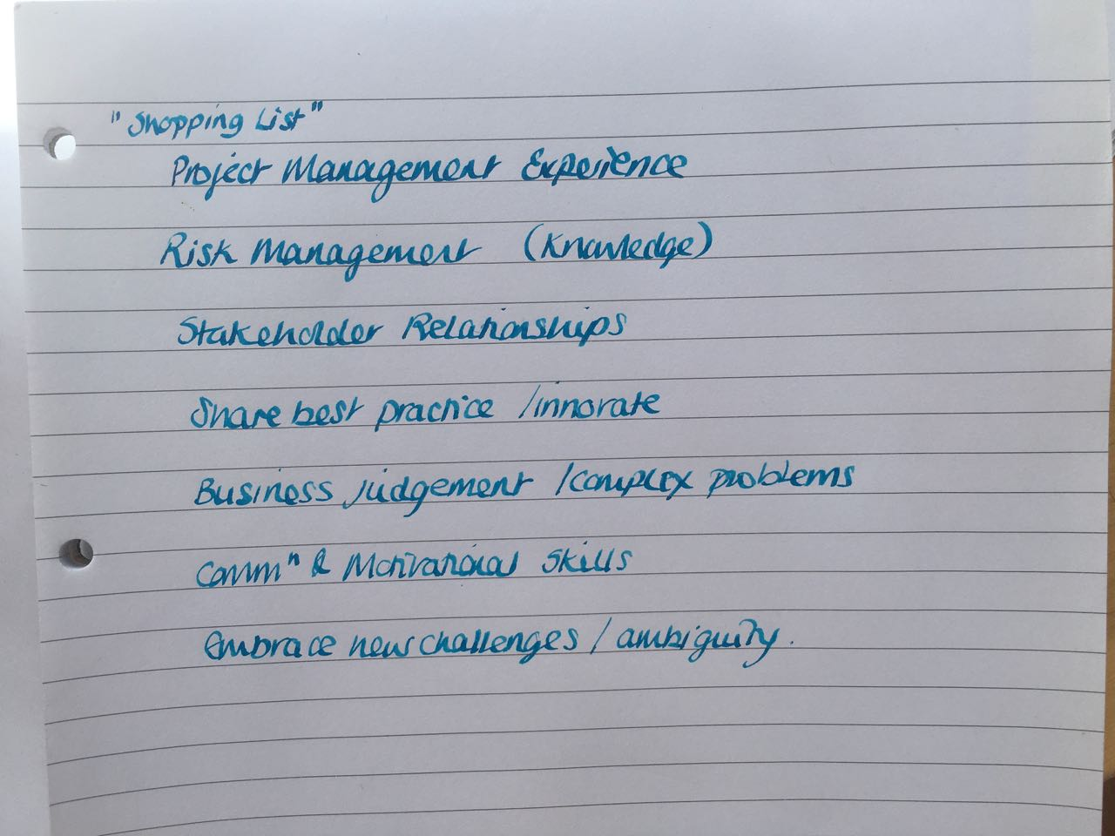
So we use the advert

Slide 13
Second VITAL message
Don’t be tempted to adapt a CV written for something VERY diffferent – it shows

Slide 14
ONLY NOW do we blow the dust off our CV
I’m going to take a quick look at two real CVs
A couple of notes!
They are “raw” materials
They aren’t tailored to this job
They possibly don’t want a job like this

Slide 15
Getting ready to write the CV
Start with wishlist
Mind map or brainstorm all possible evidence
Rank importance
Don’t be restricted by employment/interest/skills - just get key information down

Slide 16
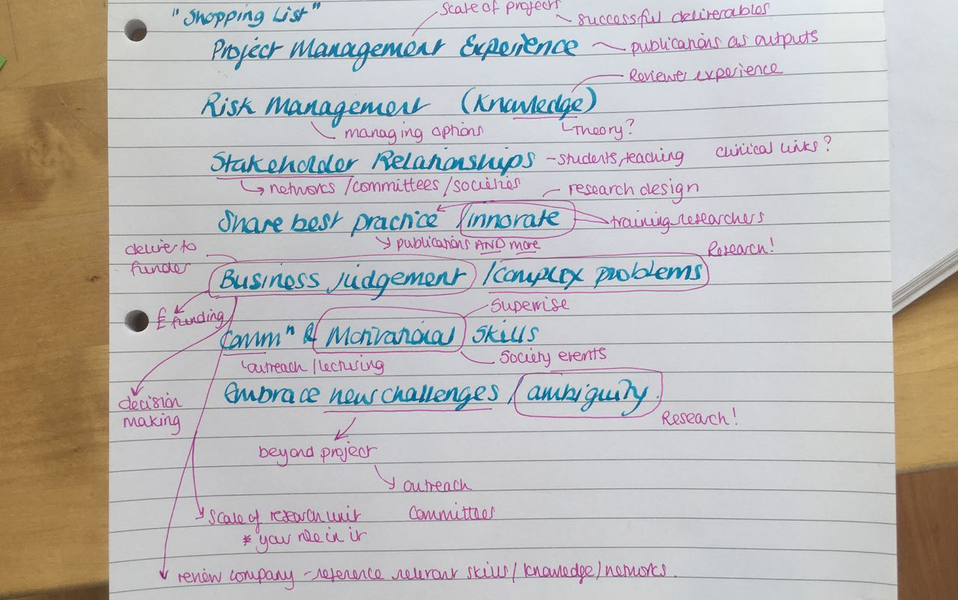

Slide 17
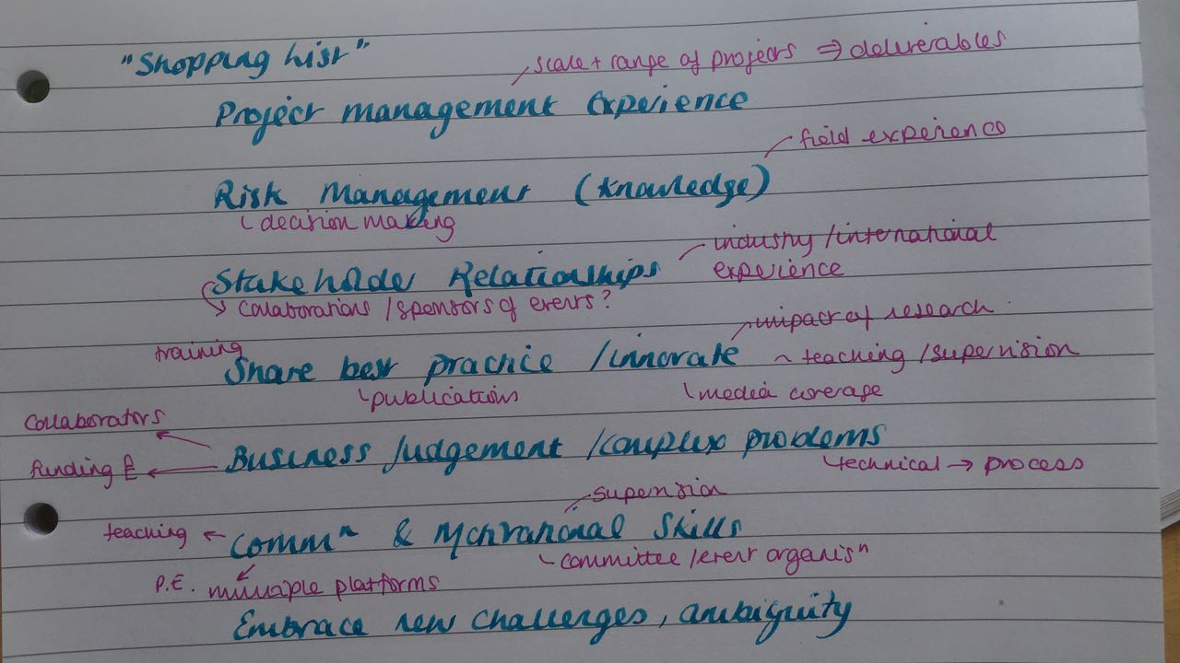

Slide 18
We’ve got our constituent parts… time to think about structure and format

Slide 19
Third VITAL message
There is no set structure, although there are some norms

Slide 20
Structure the CV
Look at your top ranked information and give it the spotlight
Are there natural headings and ways to group the information?
Are these going to be relevant to an employer?

Slide 21
Headings for this employer?
Project Management
Stakeholder Engagement
Risk Management and Problem Solving
Communication and People Management

Slide 22
Format the CV
Look around the web for stylish examples
Balance white space and text
Don’t drown the best bits in the details
MUST BE EASY TO READ
Don’t get over-excited (it’s not a party invitation)

Slide 23
Fourth VITAL message
Anything beyond the second page really needs to justify its existence

Slide 24
Control the CV
2 pages as a guide
(More acceptable for academic but not for most roles)
Use footers and design tricks to be efficient with space
Always think – “would I be telling them this if we met face to face?”

Slide 25
Why no examples?
Help you resist the temptation to copy
Smash the myth that there’s a format – always about the job
Forces you to think about YOU and the JOB and construct the best match

Slide 26
Present Yourself as a Future Asset
Clear on YOUR contribution and drive (referees to back up)
Positive language (get a friend to read it!)
Position this role in your career, but DON’T make it about benefit to you
Focus on RELEVANT aspects – the results, the outcomes and what counts to them (relationship building, problem solving, meeting deadlines, being flexible)
Keep thinking about what you would say FACE to FACE

Slide 27
Useful sometimes
A career profile
A skills summary (VERY targetted)
Appendices (if something is REALLY critical)

Slide 28
Fifth VITAL message
Introduce and position the CV with a letter

Slide 29
The letter
Positions the CV and brings you to life
Your motivation (in the context of their needs) and your value (in the context of their needs)
Not about how great this is for you. NEVER.
Any narrative aspects that don’t fit the CV

Slide 30
Five Key Messages
A CV is tailored to a specific role and vacancy
Don’t be tempted to adapt a CV written for something VERY different – it shows
There is no set structure, although there are some norms
Anything beyond the second page really needs to justify its existence
Introduce and position the CV with a letter

Slide 31
Resources
IAD Website
https://www.ed.ac.uk/institute-academic-development/research-roles/research-only-staff/career-management > CV advice
Vitae Researchers’ Portal
www.vitae.ac.uk > careers > CV examples
Graduate Prospects
www.prospects.ac.uk > Careers advice / CVs and covering letters
Science (magazine)
http://sciencecareers.sciencemag.org Articles and career resources
Articles and Top Tips
www.jobs.ac.uk/careers-advice

